Slide 1
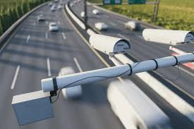
Traffic Camera Browser
OOAD 16
Khashayar Amirsohrabi, Zhihuang Chen

Slide 2
Details
At present, many cities have deployed traffic cameras and made them freely accessible to the public. However, due to factors such as operational costs, these cameras only allow real-time viewing (with time limits for viewing), and users cannot view past recordings. Our team aims to build an affordable, retroactive traffic camera video browsing platform for users to watch these videos at any time. Users can view the playback of any camera from the past 72 hours (temporary plan) through our platform.

Slide 3
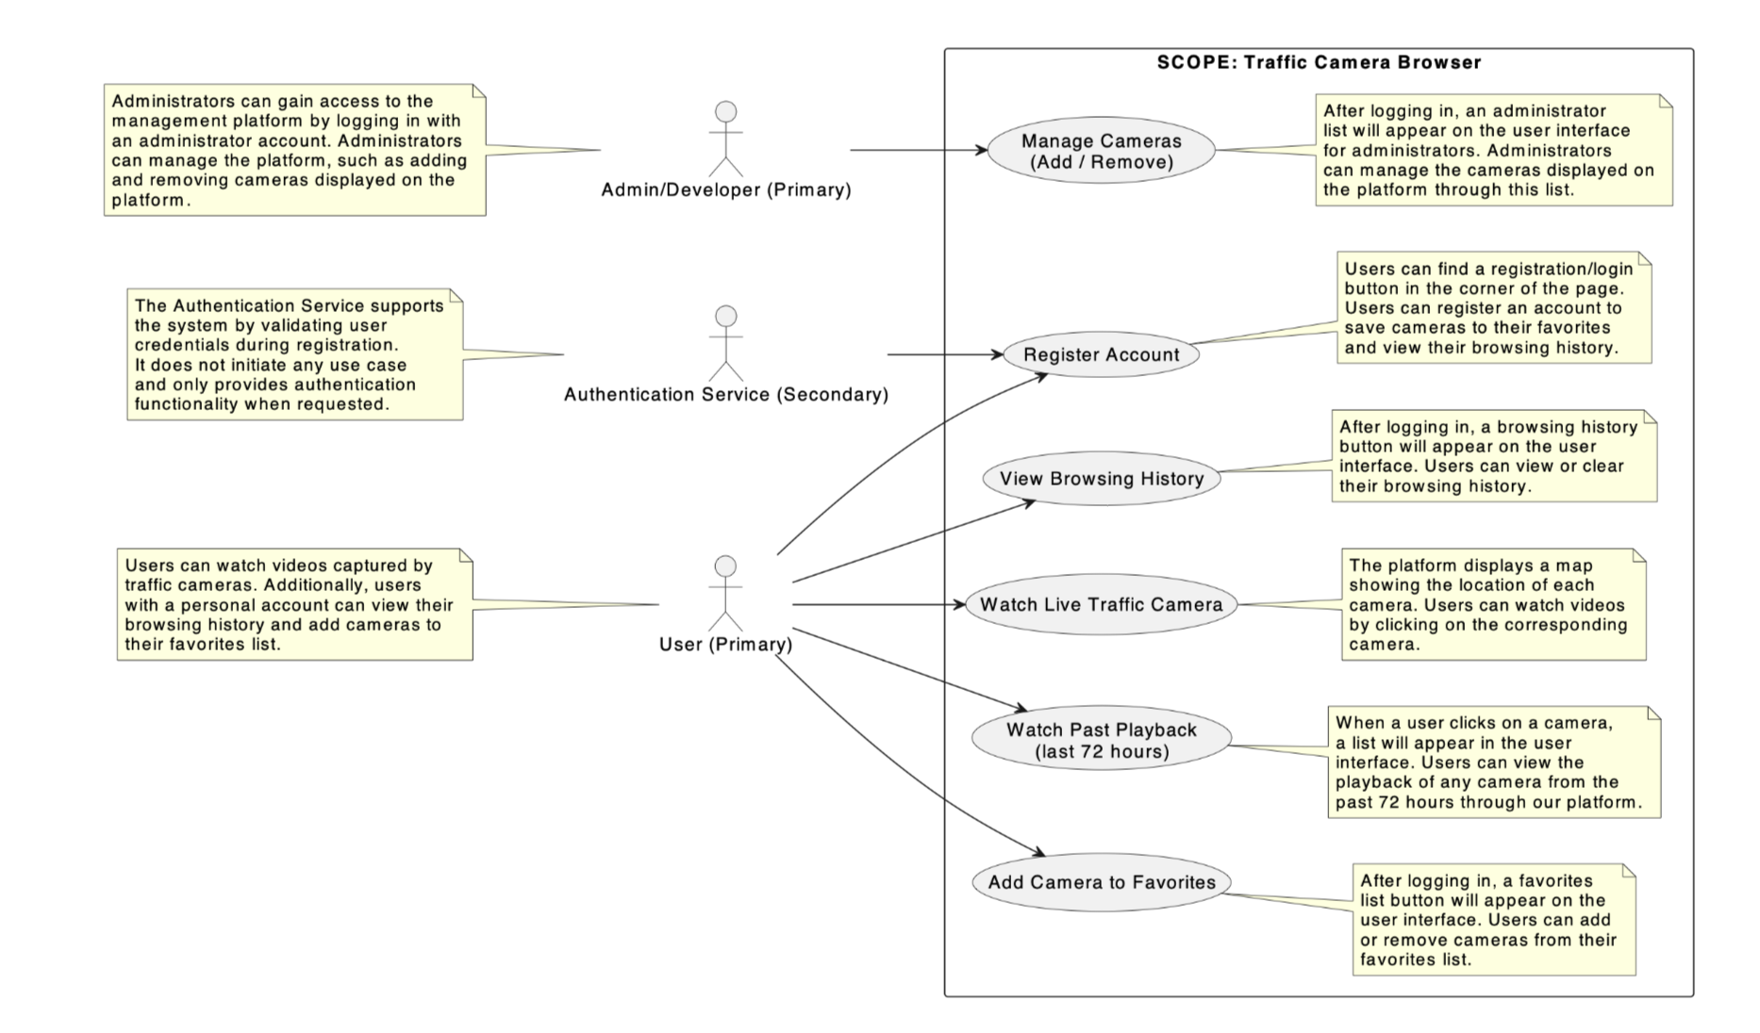
Use Case

Slide 4
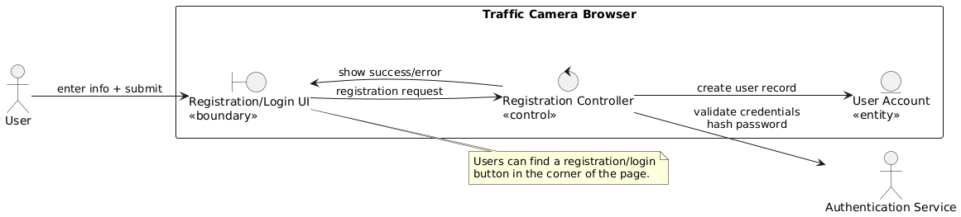
Ues Case 1: Register Account

Slide 5
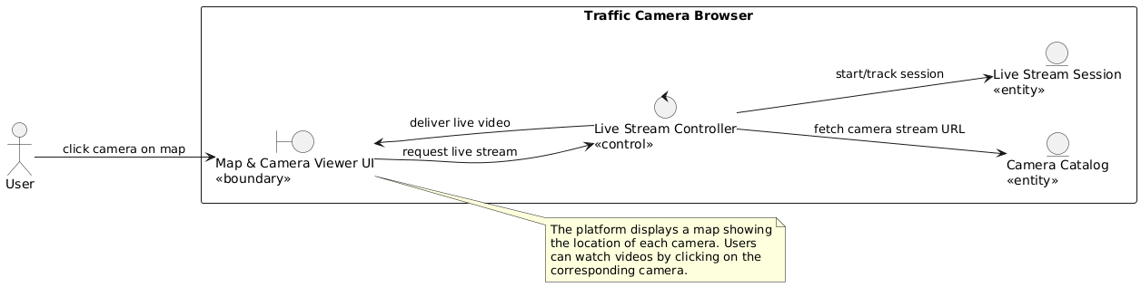
Use Case 2: Watch Live Traffic Camera

Slide 6
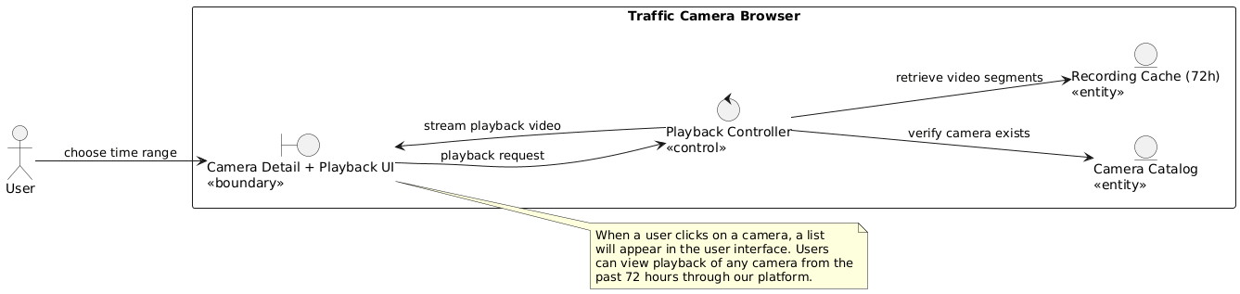
Use Case 3: Watch Past Playback

Slide 7
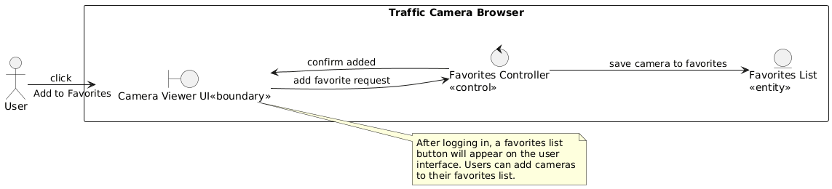
Use Case 4: Add Camera to Favorites

Slide 8
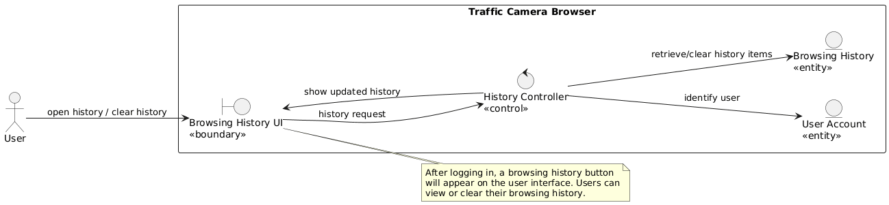
Use Case 5: View Browsing History

Slide 9
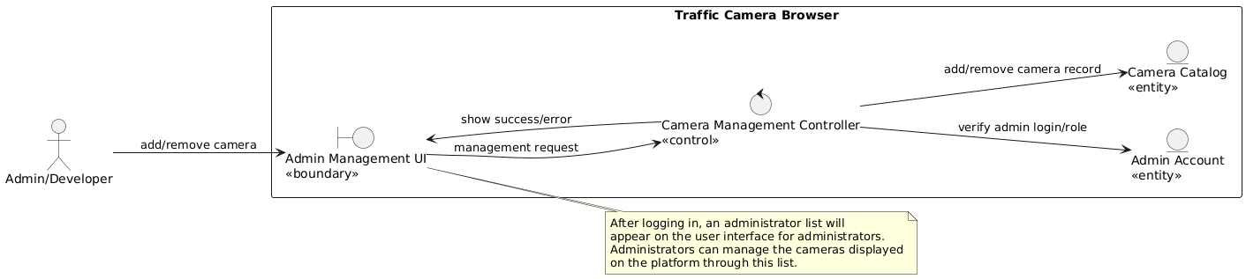
Use Case 6: Manage Cameras

Slide 10
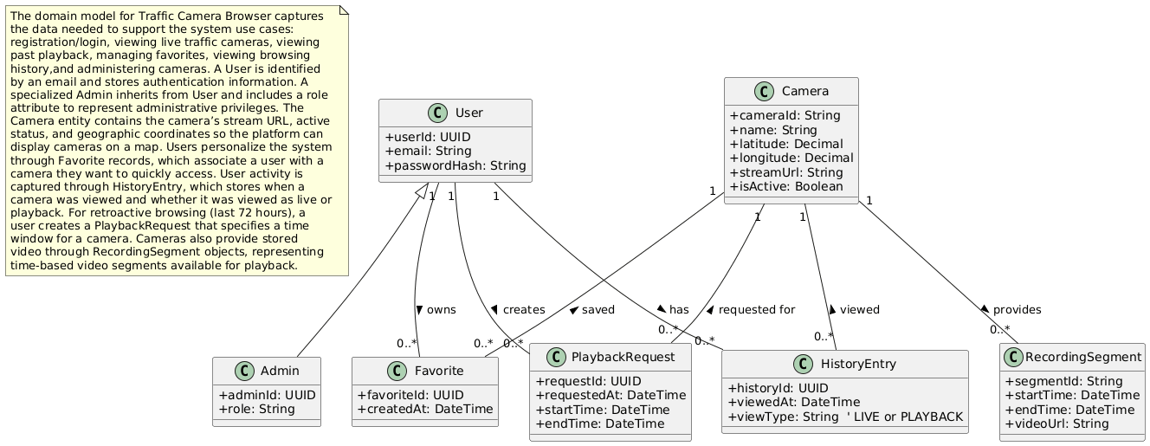
Domain Model

Slide 11
Thank You!

